Slide 1
Task

Slide 2
Problem Statement: We can assume that we may have few problems at the beginning.
Lets assume that we have a situation where the current manual methods used in the software development process are leading to several issues like
Inefficiency and Time-consuming: The existing processes are not optimal, likely requiring more time and effort than necessary, which could be due to outdated methods or unnecessary steps in the workflow.
Frequent Human Errors: Manual processes are prone to mistakes because they rely on individuals who can overlook or mishandle aspects of the development cycle.
Delays: The workflow is probably slow, causing projects to take longer than expected, which could be due to the aforementioned inefficiencies and errors.
Inconsistencies: The lack of standardization could be resulting in different outcomes even when the same procedures are supposedly followed. This could affect the quality and predictability of the deliverables.
Impact on Delivery Timelines: The culmination of the above problems is causing the team to miss deadlines and extend the time required to deliver software products.
Overall Productivity: The collective impact of these issues is negatively affecting the productivity of the development team, meaning they are producing less work than they could be if the process were more streamlined.

Slide 3
Methodology:
We will try to implement the Agile methodology to achieve the above problem.
1. Client Interatcion
2. Development and Prototyping
3. Rigorous Testing
4. Workflow Integration
5. Staging and Validation
6. Release Management
7. Monitoring and Feedback Loop
8. Rollback Strategy
9. Documentation and Training
10. Evaluation and Continuous Improvement
By following this methodology, We will be able to create an automated and efficient CI/CD pipeline that aligns with the client's requirements, improves productivity, reduces errors, and ensures a reliable and faster software delivery process. In next slide we will see the High Level of architecture.

Slide 4
Tools
GitOps apporach
Github for Source code
Sonarqube for static code test
Trivy for Docker image scan
Github action for CICD pipeline
ArgoCD for deployment of application
Helm chart for easy to manage application as charts.
Dockerized applications

Slide 5
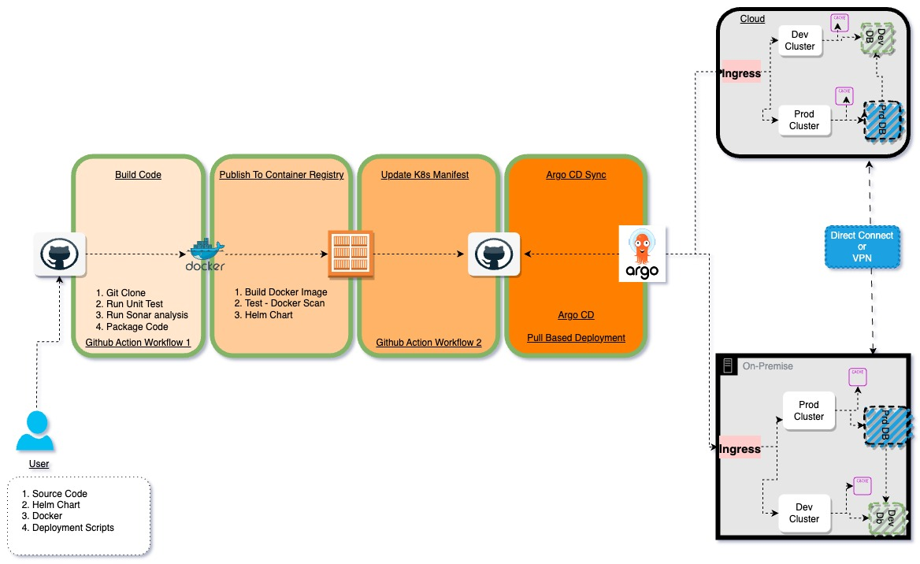
We assume that we have hybrid cloud and we want active/passive environment.

Slide 6
Pseudocode of Pipeline and ArgoCD
Here User will check-in the code or create PR which will trigger the GITHUB ACTION WORKFLOW 1 (CI Pipeline) by the modification of event on repo. Assumption 1
The GITHUB ACTION WORKFLOW 1 will run steps mentioned in pipeline i.e. build, compile, and test your application and then package it in a Docker container and publish it to a container repository.
The GITHUB ACTION WORKFLOW 1 passes the Docker image name and tag as input and triggers the GITHUB ACTION WORKFLOW 2, which will update the helm chart's dev or prod wrapper manifest file and commit and push the changes to the Application/K8s Configuration repository.
Argo CD will be pulling this change and update the application on the K8s cluster.
We will be using "sync app" as manual for production and automatic for development. Assumption 2
For Dev Env, ArgoCD will pick up the values from helm's dev-value.yaml manifest and apply the changes to Dev Cluster. (ArgoCD runs Helm in backend to generate the helm templates and then apply it on cluster).
Once we have verified the application is working as expected in Dev, UAT, Staging env then we will go to ArgoCD UI and manually sync the application for Production environment.
For Prod Env, ArgoCD will pick up the values from helm prod-value.yaml manifest and apply for changes to prod cluster. . This time ArgoCD will deploy the changes to On-Prem and Cloud K8 cluster simulatenously.
The default rolling update will take place, and which we can see in the Argo CD UI that the new version being deployed first and then the containers running the old version being terminated after. Rollback
We will navigate to the ArgoCD web UI and select the application you want to rollback. Check the "REVISION HISTORY" section. Find the revision you want to rollback to and click on the "ROLLBACK" button next to it. In the confirmation dialog box, click "ROLLBACK" to confirm the rollback.

Slide 7
Value and Benefits:
Rollback Mechanism - Argo CD Rollbacks can be easily triggered from the UI or CLI, but the idea of GitOps is to rely on Git and revert your changes and let the CI/Argo CD do its magic. Argo CD deployment strategies aka Rollouts include blue-green and canary among others.
Logging and Monitoring - Set up logging and monitoring for all clusters and applications. Tools like Prometheus and Grafana can be used for this purpose.
Security Consideration We also can limit in GutHub who can commit to the repo (application and K8s config repos), who can review and merge pull requests, etc.
Secret Management: Implement a secure method for managing secrets and sensitive configurations. Tools like HashiCorp Vault or Kubernetes Secrets can be integrated into your pipeline.
Documentation and Runbooks: Maintain comprehensive documentation and runbooks for the pipeline, covering deployment procedures, environment-specific configurations, and troubleshooting steps.
Audit and Compliance: Ensure compliance with security and audit requirements in your pipeline. Implement measures for auditing and tracking changes to the infrastructure.

Slide 8
Lessons We Learned
With this experience highlighted the importance of collaboration and communication. Involving stakeholders from the beginning ensures that the automation solution aligns closely with the actual needs and expectations. Additionally, the iterative nature of software development was reinforced—being open to feedback and making adjustments as needed is key to success.

